Slide 1
DATABASE MANAGEMENT SYSTEMS
Subject Teacher: Junaid Javed Korai

Slide 2
SINGLE ROW FUNCTIONS
Lecture # 13 & 14
Disclaimer: The material used in this presentation to deliver the lecture i.e., definitions/text and pictures/graphs etc. does not solely belong to the author/presenter. The presenter has gathered this lecture material from various sources on web/textbooks. Following sources are especially acknowledged:
Connolly, Thomas M., and Carolyn E. Begg. Database systems: a practical approach to design, implementation, and management. Pearson
Education, 2005.
Gorman,Tim, Inger Jorgensen, Melanie Caffrey, and Lex deHaan. Beginning Oracle SQL: For Oracle Database 12c.Apress, 2014.
Greenberg, Nancy, and Instructor Guide PriyaNathan. "Introduction to Oracle9i: SQL." ORACLE, USA (2001).
2

Slide 3
OBJECTIVES
After completing this lesson, you should be able to do the following:
Describe various types of functions available in SQL
Use character, number, and date functions in SELECT statements
Describe the use of conversion functions

Slide 4





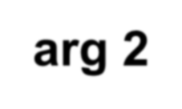






SQL FUNCTIONS
Input
Function
Output
arg 1
Function
performs action
arg 2
Result value
arg n

Slide 5












TWO TYPES OF SQL FUNCTIONS
Functions
Single-row functions
Multiple-row functions

Slide 6
SINGLE-ROW FUNCTIONS
Single row functions:
Manipulate data items
Accept arguments and return one value
Act on each row returned
Return one result per row
May modify the data type
Can be nested
Accept arguments which can be a column or an expression
function_name [(arg1, arg2,...)]

Slide 7















SINGLE-ROW FUNCTIONS
Character
General
Number
Single-row functions
Date
Conversion

Slide 8












CHARACTER FUNCTIONS
Character functions
Case-manipulation functions
Character-manipulation
functions
LOWER UPPER INITCAP
CONCAT SUBSTR LENGTH INSTR
LPAD | RPAD TRIM REPLACE

Slide 9
CASE MANIPULATION FUNCTIONS
These functions convert case for character strings.
Function
Result
LOWER('SQL Course')
UPPER('SQL Course') INITCAP('SQL Course')
sql course
SQL COURSE
Sql Course

Slide 10


USING CASE MANIPULATION FUNCTIONS
Display the employee number, name, and department number for employee
Higgins:
SELECT empno, ename, deptno
FROM
WHERE
emp
ename = 'higgins';
no rows selected
SELECT empno, ename, deptno FROM emp
WHERE
LOWER(ename) = 'higgins';

Slide 11
CHARACTER-MANIPULATION FUNCTIONS
These functions manipulate character strings:
Function | Result
CONCAT('Hello', 'World') | HelloWorld
SUBSTR('HelloWorld',1,5) | Hello
LENGTH('HelloWorld') | 10
INSTR('HelloWorld', 'W') | 6
LPAD(salary,10,'*') | *****24000
RPAD(salary, 10, '*') | 24000*****
TRIM('H' FROM 'HelloWorld') | elloWorld

Slide 12
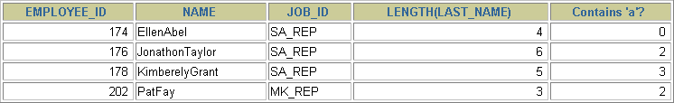
USING THE CHARACTER-MANIPULATION FUNCTIONS
1
SELECT employee_id, CONCAT(first_name, last_name) NAME,
2
3
job_id, LENGTH (last_name),
INSTR(last_name, 'a') "Contains 'a'?"
FROM WHERE
employees
SUBSTR(job_id, 4) = 'REP';
1
2
3

Slide 13
NUMBER FUNCTIONS
ROUND: Rounds value to specified decimal
ROUND(45.926, 2)
TRUNC: Truncates value to specified decimal
TRUNC(45.926, 2)
MOD: Returns remainder of division
MOD(1600, 300)
45.93
45.92
100

Slide 14
USING THE ROUND FUNCTION
1
2
SELECT
ROUND(45.923,2) |  | , |  | ROUND(45.923,0),
 | ROUND(45.923,-1)
3
FROM
DUAL;
1 2
DUAL is a dummy table you can use to view results
from functions and calculations.
3

Slide 15
USING THE TRUNC FUNCTION
1
2
SELECT
TRUNC(45.923,2), |  |  | TRUNC(45.923)
 | TRUNC(45.923,-2)
,
3
FROM
DUAL;
1
2
3

Slide 16

Calculate the remainder of a salary after it is divided by 5000 for all employees whose job title is sales representative.
USING THE MOD FUNCTION
SELECT last_name, salary,
MOD(salary, 5000)
FROM
WHERE
employees
job_id = 'SA_REP';

Slide 17


WORKING WITH DATES
Oracle database stores dates in an internal numeric format: century, year, month, day, hours, minutes, seconds.
The default date display format is DD-MON-RR.
  Allows you to store 21st century dates in the 20th century by specifying only
the last two digits of the year.
  Allows you to store 20th century dates in the 21st century in the same way.
SELECT last_name,
hire_date
FROM employees
WHERE
last_name like 'G%';

Slide 18
WORKING WITH DATES
SYSDATE is a function that returns:
Date
Time

Slide 19
ARITHMETIC WITH DATES
Add or subtract a number to or from a date for a resultant date value.
Subtract two dates to find the number of days between those dates.
Add hours to a date by dividing the number of hours by 24.

Slide 20

USING ARITHMETIC OPERATORS WITH DATES
SELECT last_name,
(SYSDATE-hire_date)/7 AS WEEKS
FROM employees WHERE
department_id = 90;

Slide 21
DATE FUNCTIONS
Function | Description
MONTHS_BETWEEN | Number of months between two dates
ADD_MONTHS | Add calendar months to date
NEXT_DAY | Next day of the date specified
LAST_DAY | Last day of the month
ROUND | Round date
TRUNC | Truncate date

Slide 22
USING DATE FUNCTIONS
MONTHS_BETWEEN ('01-SEP-95','11-JAN-94')
19.6774194
ADD_MONTHS ('11-JAN-94',6) '11-JUL-94'
NEXT_DAY ('01-SEP-95','FRIDAY')
'08-SEP-95'
LAST_DAY('01-FEB-95')
'28-FEB-95'

Slide 23
USING DATE FUNCTIONS
Assume SYSDATE = '25-JUL-95':
ROUND(SYSDATE,'MONTH')
01-AUG-95
ROUND(SYSDATE ,'YEAR')
01-JAN-96
TRUNC(SYSDATE ,'MONTH')
01-JUL-95
TRUNC(SYSDATE ,'YEAR')
01-JAN-95

Slide 24
PRACTICE 3, PART ONE: OVERVIEW
This practice covers the following topics:
Writing a query that displays the current date
Creating queries that require the use of numeric, character, and date functions
Performing calculations of years and months of service for an employee

Slide 25








CONVERSION FUNCTIONS
Data type conversion
Implicit data type conversion
Explicit data type conversion

Slide 26
IMPLICIT DATA TYPE CONVERSION
For assignments, the Oracle server can automatically convert the following:
From | To
VARCHAR2 or CHAR | NUMBER
VARCHAR2 or CHAR | DATE
NUMBER | VARCHAR2
DATE | VARCHAR2

Slide 27
IMPLICIT DATA TYPE CONVERSION
For expression evaluation, the Oracle Server can automatically convert the following:
From | To
VARCHAR2 or CHAR | NUMBER
VARCHAR2 or CHAR | DATE

Slide 28
EXPLICIT DATA TYPE CONVERSION
TO_NUMBER
TO_DATE
NUMBER
CHARACTER
DATE
TO_CHAR
TO_CHAR

Slide 29
TO_CHAR(date, 'format_model')
USING THE TO_CHAR FUNCTION WITH DATES
The format model:
Must be enclosed in single quotation marks and is case sensitive
Can include any valid date format element
Has an fm element to remove padded blanks or suppress leading zeros
Is separated from the date value by a comma

Slide 30
ELEMENTS OF THE DATE FORMAT MODEL
YYYY | Full year in numbers
YEAR | Year spelled out
MM | Two-digit value for month
MONTH | Full name of the month
MON | Three-letter abbreviation of the month
DY | Three-letter abbreviation of the day of the week
DAY | Full name of the day of the week
DD | Numeric day of the month

Slide 31
HH24:MI:SS AM
ELEMENTS OF THE DATE FORMAT MODEL
Time elements format the time portion of the date.
15:45:32 PM
Add character strings by enclosing them in double quotation marks.
DD "of" MONTH
12 of OCTOBER
Number suffixes spell out numbers.
ddspth
fourteenth

Slide 32
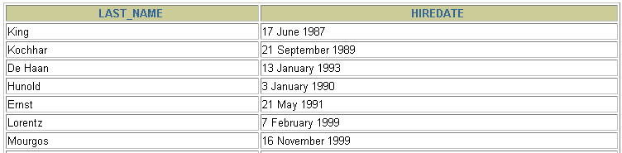
USING THE TO_CHAR FUNCTION WITH DATES
SELECT last_name,
TO_CHAR(hire_date, 'fmDD Month YYYY')
AS HIREDATE
FROM
employees;
…

Slide 33
USING THE TO_CHAR FUNCTION WITH NUMBERS
TO_CHAR(number, 'format_model')
These are some of the format elements you can use with the TO_CHAR
function to display a number value as a character:
9 | Represents a number
0 | Forces a zero to be displayed
$ | Places a floating dollar sign
L | Uses the floating local currency symbol
. | Prints a decimal point
, | Prints a thousand indicator

Slide 34
SELECT FROM WHERE
USING THE TO_CHAR FUNCTION WITH NUMBERS
TO_CHAR(salary, '$99,999.00') SALARY
employees
last_name = 'Ernst';

Slide 35
USING THE TO_NUMBER AND TO_DATE FUNCTIONS
Convert a character string to a number format using the TO_NUMBER function:
TO_NUMBER(char[, 'format_model'])
Convert a character string to a date format using the TO_DATE function:
TO_DATE(char[, 'format_model'])
These functions have fx modifier.This modifier specifies the exact matching for the character argument and date format model of a TO_DATE function

Slide 36






RR DATE FORMAT
Current Year | Specified Date | RR Format | YY Format
1995 | 27-OCT-95 | 1995 | 1995
1995 | 27-OCT-17 | 2017 | 1917
2001 | 27-OCT-17 | 2017 | 2017
2001 | 27-OCT-95 | 1995 | 2095
 |  | If the specified two-digit year is:
 |  | 0–49 | 50–99
If two digits of the current year are: | 0–49 | The return date is in the current century | The return date is in the century before the current one
 | 50–99 | The return date is in the century after the current one | The return date is in the current century

Slide 37

EXAMPLE OF RR DATE FORMAT
To find employees hired prior to 1990, use the RR format, which produces the same results whether the command is run in 1999 or now:
SELECT last_name, TO_CHAR(hire_date, 'DD-Mon-YYYY') FROM employees
WHERE hire_date < TO_DATE('01-Jan-90', 'DD-Mon-RR');

Slide 38
NESTING FUNCTIONS
Single-row functions can be nested to any level.
Nested functions are evaluated from deepest level to the least deep level.
F3(F2(F1(col,arg1),arg2),arg3)
Step 1 = Result 1
Step 2 = Result 2
Step 3 = Result 3

Slide 39
NESTING FUNCTIONS
SELECT last_name,
NVL(TO_CHAR(manager_id), 'No Manager')
FROM WHERE
employees manager_id IS NULL;

Slide 40
GENERAL FUNCTIONS
These functions work with any data type and pertain
to using nulls.
NVL (expr1, expr2)
NVL2 (expr1, expr2, expr3)
NULLIF (expr1, expr2)
COALESCE (expr1, expr2, ..., exprn)

Slide 41
Converts a null to an actual value.
NVL FUNCTION
Data types that can be used are date, character, and number.
Data types must match:
  NVL(commission_pct,0)
  NVL(hire_date,'01-JAN-97')
  NVL(job_id,'No Job Yet')

Slide 42
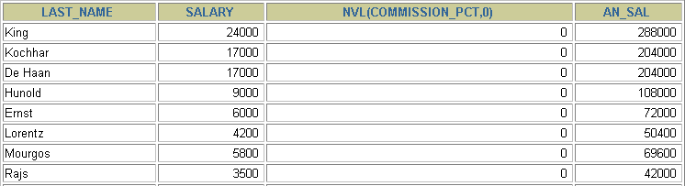
USING THE NVL FUNCTION
1
SELECT last_name, salary, NVL(commission_pct, 0),
(salary*12) + (salary*12*NVL(commission_pct, 0)) AN_SAL
2
FROM employees;
…
1
2

Slide 43
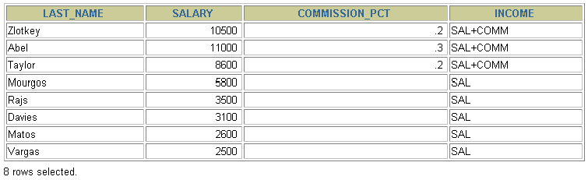
USING THE NVL2 FUNCTION
1
SELECT last_name, salary,
commission_pct
,
NVL2(commission_pct, 'SAL+COMM', 'SAL') income
2
FROM
employees WHERE department_id IN (50, 80);
1
2

Slide 44
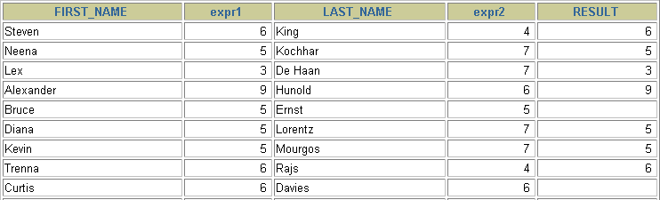
USING THE NULLIF FUNCTION
1
SELECT first_name, LENGTH(first_name) "expr1", last_name, LENGTH(last_name) "expr2",
2
NULLIF(LENGTH(first_name), LENGTH(last_name)) result
3
FROM employees;
…
1
2
3

Slide 45
USING THE COALESCE FUNCTION
The advantage of the COALESCE function over the NVL function is that the COALESCE function can take multiple alternate values.
If the first expression is not null, it returns that expression; otherwise, it does a COALESCE of the remaining expressions.

Slide 46
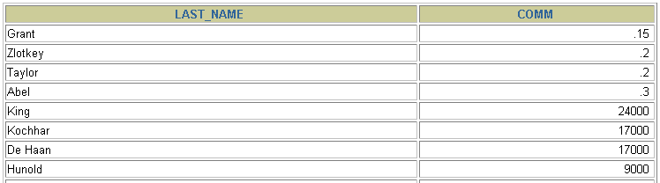
SELECT
USING THE COALESCE FUNCTION
last_name,
COALESCE(commission_pct, salary, 10) comm
FROM employees ORDER BY commission_pct;
…

Slide 47
CONDITIONAL EXPRESSIONS
Provide the use of IF-THEN-ELSE logic within a SQL statement
Use two methods:
  CASE expression
  DECODE function

Slide 48
THE CASE EXPRESSION
Facilitates conditional inquiries by doing the work of an IF-THEN-ELSE statement:
CASE expr WHEN comparison_expr1 THEN return_expr1 [WHEN comparison_expr2 THEN return_expr2 WHEN comparison_exprn THEN return_exprn ELSE else_expr]
END

Slide 49
USING THE CASE EXPRESSION
Facilitates conditional inquiries by doing the work of an IF-THEN-ELSE statement:
SELECT last_name, job_id, salary,
CASE job_id WHEN 'IT_PROG' THEN
WHEN 'ST_CLERK' THEN
1.10*salary 1.15*salary 1.20*salary
WHEN 'SA_REP' THEN
ELSE salary END
employees;
"REVISED_SALARY"
FROM
…
…

Slide 50
THE DECODE FUNCTION
Facilitates conditional inquiries by doing the work of a CASE or IF-THEN-ELSE statement:
DECODE(col|expression, search1, result1
[, search2, result2,...,] [, default])

Slide 51
USING THE DECODE FUNCTION
SELECT last_name, job_id, salary,
DECODE(job_id, 'IT_PROG', 1.10*salary,
'ST_CLERK', 1.15*salary, 'SA_REP', 1.20*salary,
salary) REVISED_SALARY
FROM
employees;
…
…

Slide 52
USING THE DECODE FUNCTION
Display the applicable tax rate for each employee in department 80.
SELECT last_name, salary,
 | DECODE (TRUNC(salary/2000, 0, 0.00, |  | 0),
 | 1, | 0.09,
 | 2, | 0.20,
 | 3, | 0.30,
 | 4, | 0.40,
 | 5, | 0.42,
 | 6, | 0.44,
 |  | 0.45) | TAX_RATE
FROM | employees
WHERE | department_id = 80;

Slide 53
SUMMARY
In this lesson, you should have learned how to:
Perform calculations on data using functions
Modify individual data items using functions
Manipulate output for groups of rows using functions
Alter date formats for display using functions
Convert column data types using functions
Use NVL functions
Use IF-THEN-ELSE logic

